Slide 1

WELCOME TO THE CLASS
ON CONTAINER SURVEY

Slide 2
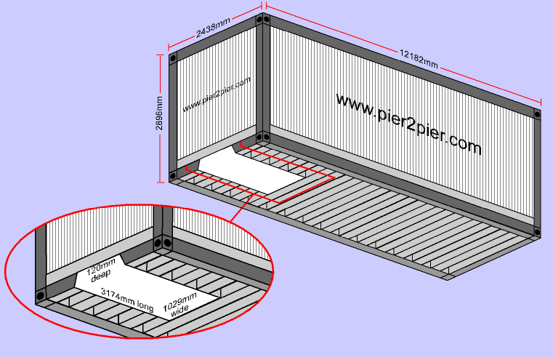
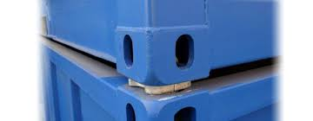
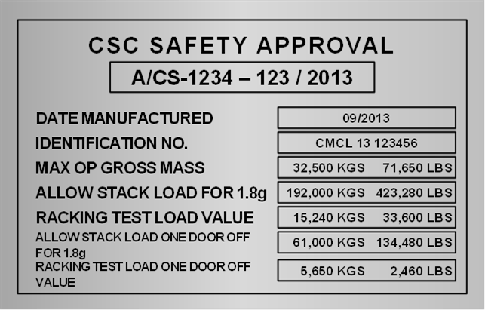
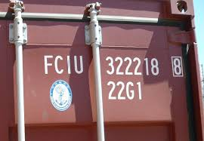
BRUSH UP OUR KNOWLEDGE

Slide 3
What is a container
A container is a large metal box of a standard design and size used for the transport of goods by road, rail, sea, or air. The goods are packed by the suppliers for safe delivery at the destination of the customers and also with the object of putting the goods in a saleable condition.
What is container Survey ??
Container survey in conformity with a standards confined to determining whether specific damage to containers requires repair, recommendations of the repair procedure to permit safe return to service, monitoring repairs.

Slide 4
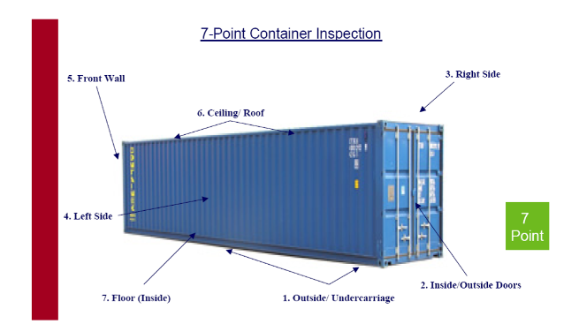
7 – Point container Inspection

Slide 5
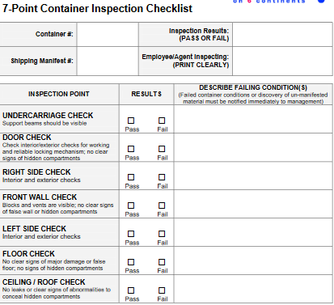
7 Point container inspection checklist

Slide 6
IICL PREFERRED CODES
COMPONENT CODE |  | DAMAGE CODE |  | REPAIR CODE
COMPONENT | CODE | DESCRIPTION | CODE | DESCRIPTION | CODE
TOP & BOTTOM RAIL | RLA | BENT | BT | INSERT | IT
HEADER/SILLL | RLA | BOWED | BW | PATCH | PT
CORNER POST | CPA | DENT | DT | SECTION | SN
UNDERSTRUCTURE- CROSSMEMBER | CMU | RUSTED | CO | STRAIGHTEN | GS
 |  | DIRTY | DY | SWEEP | WP
LOCKING BAR ASSEMBLY | LBR | CUT | CU | WELD | WD
DOOR PANEL | PAA | BROKEN | BR | WATER WASH | WW
TUNNEL PLATE | TUP | DELAMINATED | DL | PAINT | PA

Slide 7
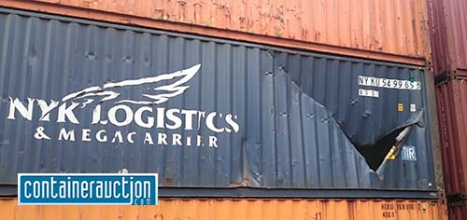
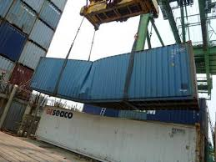
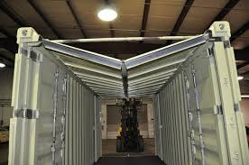
DENT, BENT AND BOW
Dent. A localized depressed in a panel or structural member made by pressure or an impact or blow that causes an abrupt change in the shape of a component over a limited area of the component
Bend. A deflection in a structural component which causes the component to change direction abruptly from that of its original design.
Bow. A gradual (not abrupt) deformation of the entire length of the component in a direction perpendicular to that length.

Slide 8
LOCATION CODING EXPLANATION
ISO FOUR (04) CHARACTER CEDEX CODE EXPLANATION
THERE ARE FOUR (04) CHARACTERS IN ISO CEDEX CODE EXPLANATION
FIRST CHARACTER- CONTAINER FACE
2. SECOND CHARACTER- CONTAINER SEGMENT
3. THIRD CHARACTER- CONTAINER SECTION
4. FOURTH CHARACTER-ALPHABET “N”- BUT SOMETIMES BASED ON CONTAINER DAMAGE THIS “N” WILL CHANGE.

Slide 9
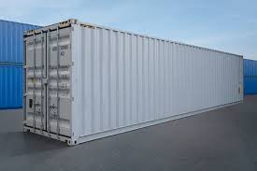
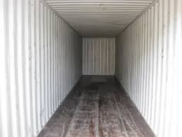
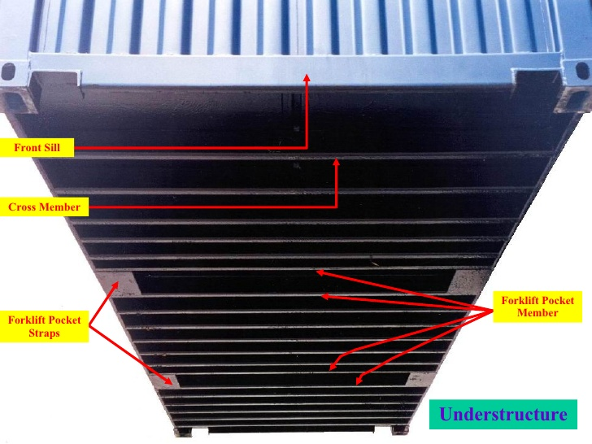
LOCATION CODING EXPLANATION
FIRST CHARACTER
FIRST CHARACTER (CONTAINER FACE)
DESCRIPTION | CODE
RIGHT SIDE | R
LEFT SIDE | L
ROOF OR TOP | T
BOTTOM (FLOOR) | B
FRONT END | F
DOOR END (REAR) | D
UNDERSTRUCTURE | U
WHOLE CONTAINER | X
CONTAINER INTERIOR | I
CONTAINER EXTERIOR | E

Slide 10
LOCATION CODING EXPLANATION
SECOND CHARACTER
CONTAINER SEGMENT
DESCRIPTION | CODE
UPPER COMPONENT | H
LOWER COMPONENT | G
TOP HALF | T
BOTTOM HALF | B
LEFT HALF | L
RIGHT HALF | R
BOTH HALVES | X
 |  | 0 | 9 | 8 | 7 | 6 | 5 | 4 | 3 | 2 | 1
 | H
L | T
 | B
 | G
 |  | Front |  |  |  |  |  |  |  |  | Door
 |  | 1 | 2 | 3 | 4 | 5 | 6 | 7 | 8 | 9 | 0
 | H
R | T
 | B
 | G
 |  | Door |  |  |  |  |  |  |  |  | Front

Slide 11
(SECTION) LOCATION CODES-20”
H | 5 | 4 | 3 | 2 | 1 | H | 1 2 | 3 4
T |  |  |  |  |  | T
L |  |  |  |  |  | D
B
 |  |  |  |  |  | B
G | FRONT |  |  |  | DOOR | G
H | 1 | 2 | 3 | 4 | 5 |  | 4 3 | 2 1
 |  |  |  |  |  | H
T
R |  |  |  |  |  | T
B |  |  |  |  |  | F
 |  |  |  |  |  | B
G | DOOR |  |  |  | FRONT
 |  |  |  |  |  | G
H | 1 | 2 | 3 | 4 | 5
T
T
B
G | DOOR |  |  |  | FRONT
H | 1 | 2 | 3 | 4 | 5
T
B
B
G | DOOR |  |  |  | FRONT
H | 1 | 2 | 3 | 4 | 5
T
U
B
G | DOOR |  |  |  | FRONT

Slide 12
(SECTION) LOCATION CODE-40”
 |  | 0 | 9 | 8 | 7 | 6 | 5 | 4 | 3 | 2 | 1
 | H
L | T
 | B
 | G
 |  | Front |  |  |  |  |  |  |  |  | Door
 |  | 1 | 2 | 3 | 4 | 5 | 6 | 7 | 8 | 9 | 0
 | H
R | T
 | B
 | G
 |  | Door |  |  |  |  |  |  |  |  | Front
 |  | 1 | 2 | 3 | 4 | 5 | 6 | 7 | 8 | 9 | 0
 | H
T | T
 | B
 | G
 |  | Door |  |  |  |  |  |  |  |  | Front
 |  | 1 | 2 | 3 | 4 | 5 | 6 | 7 | 8 | 9 | 0
 | H
B | T
 | B
 | G
 |  | Door |  |  |  |  |  |  |  |  | Front
 |  | 1 | 2 | 3 | 4 | 5 | 6 | 7 | 8 | 9 | 0
 | H
U | T
 | B
 | G
 |  | Door |  |  |  |  |  |  |  |  | Front
 | 1 2 | 3 | 4
H
D T
B
G
H | 4 3 | 2 | 1
F T
B
G

Slide 13
LOCATION CODING EXPLANATION
 |  | L
H | 1 |  |  | FACE |  | L
T |  |  |  | SEGMENT |  | T
 |  |  |  | SECTION |  | 1
 |  |  |  | ALPHABET |  | N
B
 |  |  |  | LT1N
G
 | L
 | 1 | 2 |  | FACE |  | L
H |  |  |  | SEGMENT |  | T
T |  |  |  | SECTION |  | 1
 |  |  |  |  |  | 2
B |  |  |  | LT12
G
 |  | L
H | 1 | 2 | 3 | 4 | 5 |  |  | FACE |  | L
T |  |  |  |  |  |  |  | SEGMENT |  | X | BOTH HALVES
B |  |  |  |  |  |  |  | SECTION |  | xx | FULL LENGTH
G
 |  |  |  |  |  |  |  | LX15
WHOLE DAMAGE

Slide 14
LOCATION CODING EXPLANATION
 | H | 1 2 3 4 |  |  |  | FACE |  | D
 |  |  |  |  |  | SEGMENT |  | X
D | T |  |  |  |  | SECTION |  | 1
 | B |  |  |  |  | ALPHABET |  | N
 |  |  |  |  |  | DX1N
 | G
 |  | 1 | 2 | 3 | 4 | 5 | 6 | 7 | 8 | 9 | 0 |  | FACE |  |  | B
 | L |  |  |  |  |  |  |  |  |  |  |  | SEGMENT |  |  | L
B |  |  |  |  |  |  |  |  |  |  |  |  | SECTION |  |  | 1
 | R |  |  |  |  |  |  |  |  |  |  |  | ALPHABET |  |  | N
 |  |  |  |  |  |  |  |  |  |  |  |  | BL1N
 |  | Door |  |  |  |  |  |  |  |  | Front
 |  | 1 | 2 | 3 | 4 | 5 | 6 | 7 | 8 | 9 | 0 |  | FACE |  | U
 | R |  |  |  |  |  |  |  |  |  |  |  | SEGMENT |  | X
U |  |  |  |  |  |  |  |  |  |  |  |  | SECTION |  | 1
 | L |  |  |  |  |  |  |  |  |  |  |  | ALPHABET |  | N
 |  |  |  |  |  |  |  |  |  |  |  |  | UX1N
 |  | Door |  |  |  |  |  |  |  |  | Front
 | H | 1 2 3 4 |  |  | FACE |  | F
 |  |  |  |  | SEGMENT |  | T
F | T |  |  |  | SECTION |  | 1
 | B |  |  |  |  |  | 4
 |  |  |  |  | FT14
 | G
 |  | 1 | 2 | 3 | 4 | 5 | 6 | 7 | 8 | 9 | 0 |  | FACE |  | U
 | R |  |  |  |  |  |  |  |  |  |  |  | SEGMENT |  | X
U |  |  |  |  |  |  |  |  |  |  |  |  | SECTION |  | 1
 | L |  |  |  |  |  |  |  |  |  |  |  |  |  | 6
 |  |  |  |  |  |  |  |  |  |  |  |  | UX16
 |  | Door |  |  |  |  |  |  |  |  | Front

Slide 15
LOCATION CODING EXPLANATION
 |  | 1 | 2 | 3 | 4 | 5 | 6 | 7 | 8 | 9 | 0 |  | FACE |  | U |  | U | U
 | R |  |  |  |  |  |  |  |  |  |  |  | SEGMENT |  | R |  | R | L
 |  |  |  |  |  |  |  |  |  |  |  |  | SECTION |  | 1 |  | 4 | 8
U
 | L |  |  |  |  |  |  |  |  |  |  |  | ALPHABET |  | N |  | N | N
 |  | Door |  |  |  |  |  |  |  |  | Front
 |  | 1 | 2 | 3 | 4 | 5 | 6 | 7 | 8 | 9 | 0 |  | FACE |  | U
 | R |  |  |  |  |  |  |  |  |  |  |  | SEGMENT |  | X
U |  |  |  |  |  |  |  |  |  |  |  |  | SECTION |  | 9
 | L |  |  |  |  |  |  |  |  |  |  |  | ALPHABET |  | N
 |  |  |  |  |  |  |  |  |  |  |  |  | UX9N
 |  | Door |  |  |  |  |  |  |  |  | Front
 |  | 1 | 2 | 3 | 4 | 5 | 6 | 7 | 8 | 9 | 0 |  | FACE |  | U
 | R |  |  |  |  |  |  |  |  |  |  |  | SEGMENT |  | R
 |  |  |  |  |  |  |  |  |  |  |  |  | SECTION |  | 9
U
 | L |  |  |  |  |  |  |  |  |  |  |  | ALPHABET |  | N
 |  |  |  |  |  |  |  |  |  |  |  |  | UR 9N
 |  | Door |  |  |  |  |  |  |  |  | Front

Slide 16
STRUCTURALLY SENSITIVE COMPONENTS
Ser | Component | Damage | Repair Criteria | Remarks
1 | Top Rail | Crack, Cut, Holed, Bent, Dent, Bow | 300 mm (at least) | Near Corner Post
2 | Bottom Rail | Crack, Cut, Holed, Bent, Dent, Bow | 300 mm (at least) | Near Corner Post
3 | Header | Crack, Cut, Holed, Bent, Dent, Bow | 150 mm (at least) | Near Corner Post
4 | Sill | Crack, Cut, Holed, Bent, Dent, Bow | 150 mm (at least) | Near Corner Post
5 | Corner Fittings | Anything Happens | MUST BE CHANGED
6 | Corner Post | WILL BE DISCUSSED DURING PRACTICAL
7 | Understructure | Detached from the Floor | MUST BE REPAIRED
8 | Floor Board | Delamiantion, Rolling Shear Failure, Finger Crack, Impact | Wear or Damage
9 | Locking Bar Assembly | Broken and Door Operation Obstructed | Repair
10 | Gasket | Loose, Not Light Tight or Water-Tight | MUST BE REPAIRED

Slide 17
ISO TOLERENCES OF CONTAINERS
COMPONENT | CONDITION | ACTION REQUIRED
ALL RAILS -SIDE RAILS, HEADERS & SILLS | HOLED, CUT, TORN OR CRACKED; BROKEN COMPONENT AND/OR WELD | REPAIR
ALL CORNER POSTS, FRONT AND REAR | ANY SINGLE DEFORMATION SUCH AS BEND, BOW, DENT ETC | IF MORE THAN 25 MM, REGRADLESS OF LENGTH OR LOCATION
 | TWO OR MORE DENTS ON A SINGLE POST | IF EACH IS MORE THAN 15 MM DEEP, REGARDLESS OF LENGTH OR LOCATION
ALL SIDE/FRONT PANELS | ANY DEFORMATION SUCH AS BEND, DENT ON AN INBOARD OR OUTBOARD FACE OF A CORRUGATION | IF MORE THAN 35 MM DEEP
DOOR PANEL | ANY DEFORMATION SUCH AS BEND, DENT | IF MORE THAN 35 MM DEEP
DOOR GASKET | CUT, TORN, CRACKED OR BURNED | IF NOT LIGHT-TIGHT AND WATER-TIGHT
ALL ROOF PANELS | ANY DEFORMATION SUCH AS BEND, DENT ETC | IF MORE THAN 355 MM DEEP ON ANY CORRUGATION
WOODEN FLOORING | GOUGES (REGARDLESS OF LENGTH) | IF MORE THAN 15 MM DEEP, IF MORE THAN 5 MM DEEP THROUGHOUT A WIDTH OF MORE THAN 150 MM OF THE GOUGE

Slide 18
ISO TOLERENCES OF CONTAINERS
COMPONENT | CONDITION | ACTION REQUIRED
END FRAME COMPONENTS (CORNER POSTS, FRONT PANEL, DOORS,HEADERS, SILLS, CORNER FITTINGS | ANY DEFORMATION SUCH AS BEND, BOW, DENT ETC THAT AFFECTS ISO REQUIRED DIMENSIONS | IF DEFORMATION EXCEEDS ISO TOLERANCES PLUS 5 MM REPAIR
ENTIRE CONTAINER EXCEPT END FRAME COMPONENTS | ANY DEFORMATION SUCH AS BEND, BOW, DENT ETC THAT AFFECTS ISO REQUIRED DIMENSIONS | IF DEFORMATION EXCEEDS ISO TOLERANCES PLUS 10 MM REPAIR

Slide 19
1 Square= 16 sft
 |  |  |  |  |  |  |  | CONTAINER SURVEY FORM
 |  | CONTAINER |  |  |  |  |  |  |  |  |  |  |  |  |  |  |  |  |  |  | COMPONENT | CODE |  | DAMAGE | CODE | REPAIR | CODE | REMARKS
 |  | ACCOUNT |  |  |  |  |  |  |  |  |  |  |  |  |  |  |  |  |  |  | RAILS | RLA |  | BENT | BT | INSERT | IT
 |  | DATE |  |  |  |  |  |  |  |  |  |  |  |  |  |  |  |  |  |  | PANEL | PAA |  | BROKEN, SPLIT | BR | SECTION | SN
 |  |  |  |  | SIZE |  |  | 20 |  | 40 |  | 45 |  |  | 40 HC |  |  |  |  |  | CORNER POST | CPS |  | BOWED | BW | PATCH | PT
 |  | TYPE |  |  | GP |  | OT |  | RF |  | FR |  | TANK |  |  |  |  |  |  |  | CORNER FITTING | CFG |  | CRACKED | CK | SAND | SD
 |  |  |  |  |  |  |  |  |  |  |  |  |  |  |  |  |  |  |  |  | CORNER POST- J BAR | CPJ |  | CORRODED/RUSTED | CO | DEODORIZE | DO
 |  |  |  |  | LEFT |  |  |  |  |  |  |  | 1 2 |  | 3 | 4 |  |  |  |  | VENTILATOR | VRA |  | CONTAMINATED | CT | STRAIGHTEN | GS
 |  | 0 | 9 | 8 | 7 | 6 | 5 | 4 | 3 | 2 | 1 | H |  |  |  |  |  |  |  |  | HINGE ASSEMBLY | HGH |  | CUT | CU | STEAM CLEAN | SC
 | H |  |  |  |  |  |  |  |  |  |  | T |  |  |  |  | DOOR |  |  |  | LOCKING BAR ASSEMBLY | LBA |  | DEBRIS,DUNNAGE | RD | LUBRICATE | LC
 | T |  |  |  |  |  |  |  |  |  |  | B |  |  |  |  |  |  |  |  | LOCKING HANDLE ASSEMBLY | DHL |  | DELAMINATED | DL | ABRASIVE CLEAN & PAINT | AB
 | B
 |  |  |  |  |  |  |  |  |  |  |  |  |  |  |  |  |  |  |  |  | LOCKING BAR CAM | LBC |  | DENT | DT | GRIND & WELD | XW
 | G |  |  |  |  |  |  |  |  |  |  | G |  |  |  |  |  |  |  |  | CAM KEEPER | RCK |  | FROZEN/SEIZED | FZ | STRAIGHTEN & WELD | GW
 |  | FRONT |  |  |  |  |  |  |  |  | DOOR |  |  |  |  |  |  |  |  |  | DOOR HANDLE RETAINER | DHR |  | GOUGED | GD | SWEEP | WP
 |  |  |  |  | RIGHT |  |  |  |  |  |  |  | 4 3 |  | 2 | 1 |  |  |  |  | DOOR HANDLE CATCH | DHC |  | HOLED | HO | WATER WASH | WW
 |  | 1 | 2 | 3 | 4 | 5 | 6 | 7 | 8 | 9 | 0 | H |  |  |  |  |  |  |  |  | GASKET | GTO |  | IMPROPER REPAIR | IR | WELD | WD
 | H |  |  |  |  |  |  |  |  |  |  | T |  |  |  |  | FRONT |  |  |  | ROOF | PSC |  | LOOSE COMPONENT | LO | SURFACE PREPARATION | PS
 | T |  |  |  |  |  |  |  |  |  |  |  |  |  |  |  |  |  |  |  | FLOOR | FPP |  | ODOR | OR | INSTALL | IN
 | B |  |  |  |  |  |  |  |  |  |  | B |  |  |  |  |  |  |  |  | CROSSMEMBER ASSEMBLY | CMA |  | OIL STAINS | OS | PREVENTIVE MAINTENANCE | VM
 | G |  |  |  |  |  |  |  |  |  |  | G |  |  |  |  |  |  |  |  | TUNNEL ASSEMBLY | TUA |  | BURNED | BN | REMOVE MARKS & NAILS | MV
 |  | DOOR |  |  |  |  |  |  |  |  | FRONT |  |  |  |  |  |  |  |  |  | TUNNEL RAIL | RTL |  | NAIL IN FLOOR | NL | SEAL OR RESEAL | SE
 |  |  |  |  | TOP |  |  |  |  |  |  |  | SURVEYOR-NAME &SIGN |  |  |  |  |  |  |  | HEADER PIN CHAIN | HPC |  | PAINT FAILURE | PF | REMOVE GLUE OR TAPE | GT
 |  | 1 | 2 | 3 | 4 | 5 | 6 | 7 | 8 | 9 | 0 |  |  |  |  |  |  |  |  |  | TARPAULIN ASSY | TNA |  | PIN HOLES | PH | CHEMICAL CLEAN | CC
 | H |  |  |  |  |  |  |  |  |  |  |  |  |  |  |  |  |  |  |  | TIR CORD | TIR |  | ROTTED | RO | FREE SEIZED COMPONENTS | FR
 | T |  |  |  |  |  |  |  |  |  |  |  |  |  |  |  |  |  |  |  | ROOF BOW | RBO |  | WEAR & TEAR | WT | REMOVE & REPLACE | RP
 | B
 |  |  |  |  |  |  |  |  |  |  |  |  |  |  |  |  |  |  |  |  | TOP RAIL-SWINGING | RRT |  | DIRTY | DY | REFIT | FT
 | G
 |  | DOOR | FRONT
 |  |  |  | BOTTOM |  |  |  |  |  |  |  |  | CONTAINER FACE |  |  |  |  |  |  | LOCATION CODE |  |  | COMPONENT CODE |  | DAMAGE CODE |  | REPAIR CODE
 |  | 1 | 2 | 3 | 4 | 5 | 6 | 7 | 8 | 9 | 0 |  | LEFT
L R |  |  |  |  |  |  |  |  |  |  |  |  | RIGHT
 |  |  |  |  |  |  |  |  |  |  |  |  | TOP
 |  | DOOR |  |  |  |  |  |  |  |  | FRONT |  | BOTTOM
 |  |  | UNDERCARRIAGE |  |  |  |  |  |  |  |  |  | UNDERCARRIAGE
 |  | 1 | 2 | 3 | 4 | 5 | 6 | 7 | 8 | 9 | 0 |  | DOOR
 | R |  |  |  |  |  |  |  |  |  |  |  | FRONT
 | L
 |  | DOOR |  |  |  |  |  |  |  |  | FRONT

Slide 20
CRITICAL PARTS DESCRIPTION WITH THE FORMATS
 | 1 2 | 3 | 4 |  |  | CONTAINER FACE |  |  | LOCATION |  | COMPONENT | CODE | DAMAGE CODE |  | REPAIR CODE | REMARKS
H |  |  |  |  |  | REAR/DOOR |  |  | DX1N |  | GASKET | GTO | BN |  | RP
DOOR T |  |  |  |  |  |  |  |  | DH4N |  | HINGE ASSY | HGH | BR |  | RE
B |  |  |  |  |  |  |  |  | DB2N |  | HANDLE | LBH | BT |  | GS
 |  |  |  |  |  |  |  |  | DX2N |  | LOCKING BAR ROD | LBR | BW |  | GS
G |  |  |  |  |  |  |  |  | DG2N |  | CAM | LBC | CU |  | RP
 |  |  |  |  |  |  |  |  |  |  |  |  | Burned |  | Remove & Replace
 |  |  |  |  |  |  |  |  |  |  |  |  | Broken |  | Resecure
 |  |  |  |  |  |  |  |  |  |  |  |  | Bent |  | Straighten
 |  |  |  |  |  |  |  |  |  |  |  |  | Bowed |  | Straighten
 |  |  |  |  |  |  |  |  |  |  |  |  | Cut |  | Remove & Replace

Slide 21


